Slide 1
Implementing Spring MVC Functionalities within Your Spring Boot Application
Module 3
PPT-Master Version 01. There will be an extensive update with the new Deutsche Bank font and sample charts at the end of August 2024.
8 May 2024, Speaker name

Slide 2

What is Spring MVC?
Spring MVC (Model-View-Controller) is a framework for building web applications.
Separates application logic, user interface, and user input.
Handles HTTP requests and responses.
Model
Controller
View
Users
db

Slide 3
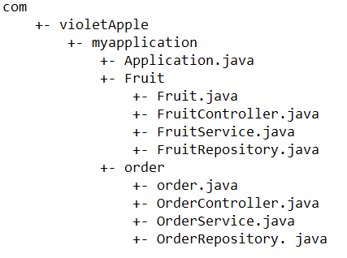
Spring Boot and Spring MVC
Spring Boot simplifies Spring MVC configuration.
Auto-configures essential components.
Embedded server for running web applications.
Typical Spring MVC project structure

Slide 4
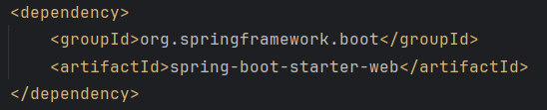
Setting Up Spring MVC in Spring Boot
No additional configuration needed if using spring-boot-starter-web.
Spring Boot automatically configures DispatcherServlet.
The core component of the Spring MVC framework that handles all HTTP requests and responses.

Slide 5
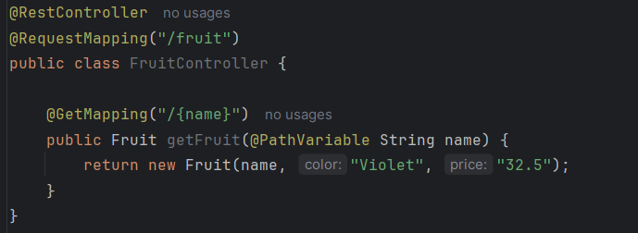
Handling Web Requests
Use @Controller to define a controller class.
Use @RequestMapping or @GetMapping, @PostMapping, etc., to map URLs to methods.
Access request parameters and path variables.
API URL/path
Get the parameter
Response from the controller

Slide 6
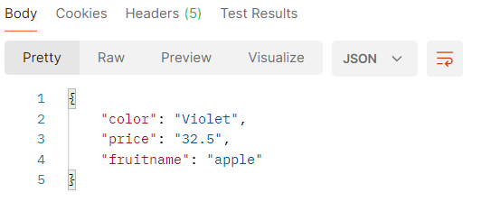
Response in Postman
Return views or data (e.g., JSON) from controller methods.
Sample output as seen in postman

Slide 7

Introduction to H2 Database
Lightweight, open-source, and fast relational database.
Written in Java and can be embedded in Java applications.
Ideal for development, testing, and small-scale applications.
In-memory database option.
Web-based H2 Console for managing the database.
Supports standard SQL and JDBC API.
Key Features

Slide 8
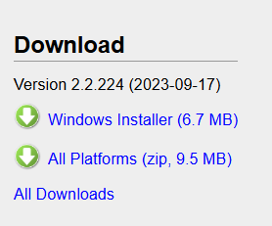
Having H2 db on your machine
Download form the official H2 website: https://www.h2database.com/html/main.html

Slide 9
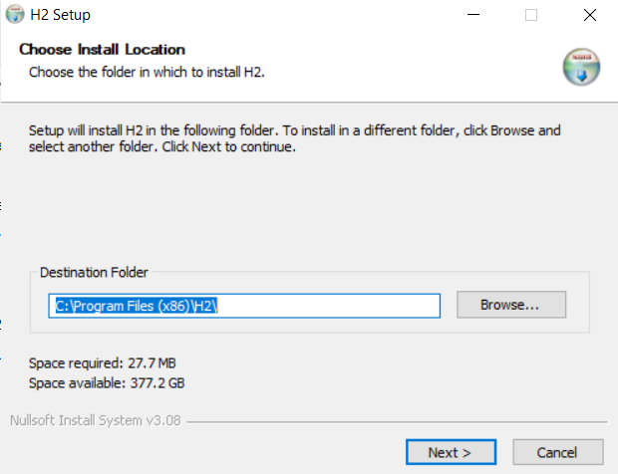
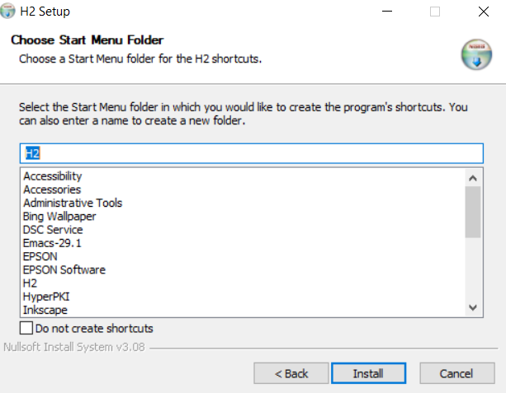
Installing H2 on your machine
Double click the downloaded setup file and follow on screen instructions.

Slide 10
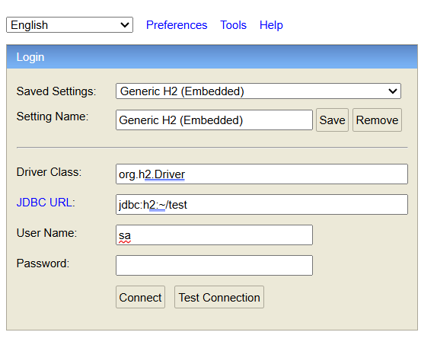
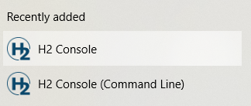
Accessing H2 db console
Go to start and click on H2 Console. This will open up web browser displaying H2 Console.
Click on connect
Default username : sa and password : password

Slide 11
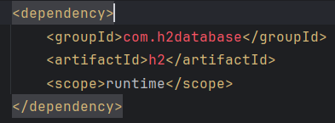
Setting Up H2 in Maven
Add H2 dependency to pom.xml.
pom.xml
H2 dependency coordinates: com.h2database:h2.
Automatic configuration in Spring Boot.

Slide 12
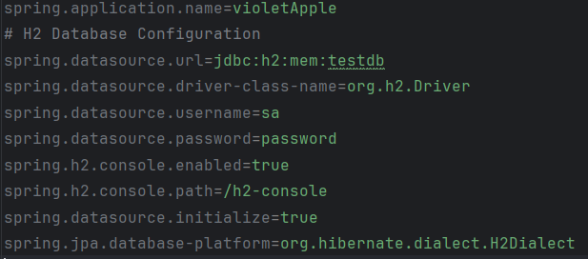
Configuring H2 in Spring Boot
No additional configuration needed for basic setup.
Spring Boot auto-configures H2 database.
Default connection URL: jdbc:h2:mem:testdb
application.properties
Parameters needed for h2 db connection

Slide 13
Building RESTful APIs with Spring MVC
REST (Representational State Transfer) is an architectural style for designing networked applications.
Uses standard HTTP methods.
Focuses on resources, represented by URLs.
REST API architecture
Delete
Application Server / Load balancer
Put
Web Apps / Mobile App
http/s
Get
Json/xml
Post

Slide 14
Key Principles of REST
Uniform Interface
Stateless-ness
Resource Identification through URLs
Client-Server Architecture
REST

Slide 15
Spring MVC and RESTful APIs
Spring MVC provides a robust framework for building RESTful APIs.
Supports easy mapping of HTTP methods to controller methods.
Facilitates data exchange in various formats (JSON, XML).
8 May 2024, Speaker name

Slide 16
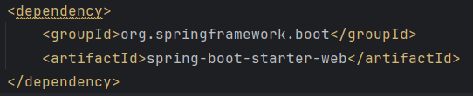
Setting Up Spring MVC for REST
Add spring-boot-starter-web dependency to pom.xml.
Spring Boot auto-configures essential components.
pom.xml

Slide 17
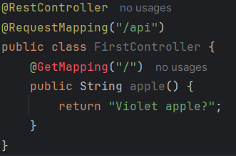
Creating a REST Controller
Use @RestController to define RESTful controllers.
Map HTTP requests to methods using @RequestMapping, @GetMapping, @PostMapping, @PutMapping, and @DeleteMapping.
@RestController: Indicates that this class is a REST controller where every method returns a domain object instead of a view.
@RequestMapping("/api"): Base URL path for all endpoints in this controller
@GetMapping("/"): Maps HTTP GET requests to the greeting method

Slide 18


Mapping HTTP Methods
@GetMapping: Handles GET requests.
@PostMapping: Handles POST requests.
@PutMapping: Handles PUT requests.
@DeleteMapping: Handles DELETE requests.

Slide 19
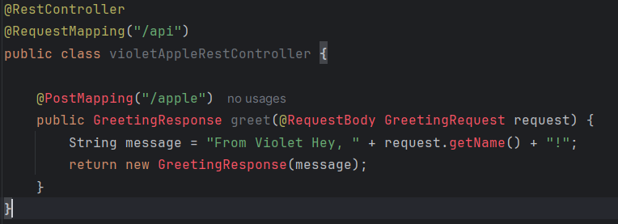
Handling Request and Response Data
Use @RequestBody to bind request data to method parameters.
Use @ResponseBody to return data as JSON or XML.
Spring Boot automatically converts Java objects to JSON or XML.
GreetingRequest: A simple class representing the request body, containing a name field.
GreetingResponse: A simple class representing the response body, containing a message field.

Slide 20
Data Formats: JSON and XML
JSON is the default format in Spring Boot.
Use MappingJackson2HttpMessageConverter for JSON.
Use Jaxb2RootElementHttpMessageConverter for XML.
8 May 2024, Speaker name

Slide 21
PowerPoint template
Frankfurt am Main
8 May 2024, Speaker name

Slide 22

Working with Spring Data JPA
A part of the Spring Data project aimed at simplifying data access.
Provides repository support for JPA (Java Persistence API).
Enables seamless interaction with relational databases.

Slide 23
Key Features of Spring Data JPA
Repository abstraction for data access.
Support for query methods and custom queries.
Integration with Spring Boot for easy configuration.
Auditing, paging, and sorting support.

Slide 24
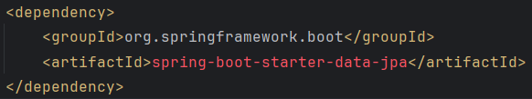
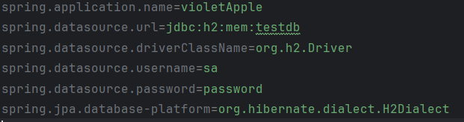
Setting Up Spring Data JPA
Add spring-boot-starter-data-jpa dependency to pom.xml.
Configure data source properties in application.properties
pom.xml
application.properties

Slide 25
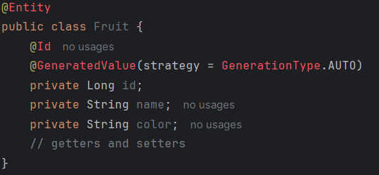
Defining an Entity
Use @Entity annotation to define a JPA entity.
Map entity fields to database columns using @Column.

Slide 26

Creating a Repository Interface
Define custom query methods using method naming conventions.
Extend JpaRepository for basic CRUD operations.

Slide 27
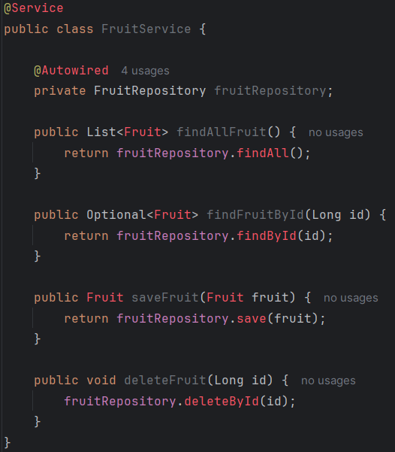
At a glance CRUD Operations
Service Layer (FruitService): Implements business logic using FruitRepository.
Repository Interface (FruitRepository): Extends JpaRepository for basic CRUD operations.
Controller (UserController): Handles HTTP requests, maps them to service layer methods for CRUD operations on User entities.

Slide 28
Advanced Spring Boot Features & Building RESTful APIs
Module 4
PPT-Master Version 01. There will be an extensive update with the new Deutsche Bank font and sample charts at the end of August 2024.
8 May 2024, Speaker name

Slide 29
Spring Security Fundamentals:
Integrating Spring Security for user authentication and authorization

Slide 30
Introduction to Spring Security
Purpose: Ensures secure authentication and authorization for Spring-based applications.
Features: Provides comprehensive security services for Java EE-based enterprise software applications.
Authentication: Verifies the identity of a user.
Methods: Form-based, Basic Authentication, OAuth, etc.
Authorization: Controls access to specific resources based on user roles and permissions.
Key Concepts

Slide 31

Integration with Spring Boot
Dependency: Include spring-boot-starter-security in pom.xml.

Slide 32
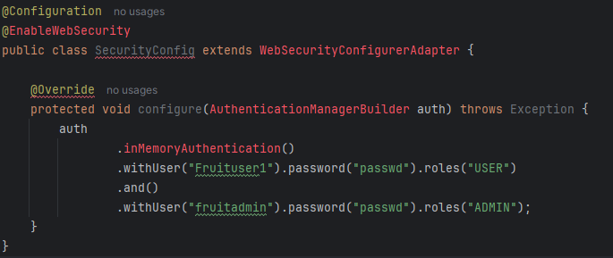
In-Memory Authentication
@EnableWebSecurity: Enables Spring Security's web security support.
WebSecurityConfigurerAdapter: Base class to customize Spring Security's Java-based configuration.
.inMemoryAuthentication(): Starts configuring in-memory authentication.
.withUser(“Fruituser1").password("passwd").roles("USER"): Adds a user with username "user1", password "password1", and role "USER".

Slide 33
In-Memory Authentication Benefits
Simple configuration for testing and development.
Useful for small applications or quick prototyping.
Easy Setup: Quickly configure users and roles directly in the application.
Limitations: Not suitable for production. As password is stored in plaintext.
Use Cases: Ideal in case rapid application development and testing.
Key Points

Slide 34
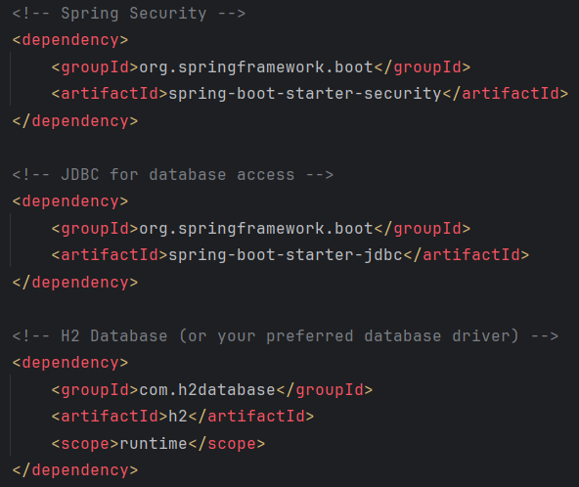
Authentication Providers
Add requisite dependencies for JDBC to pom.xml file.
Integration with external authentication providers, such as JDBC

Slide 35
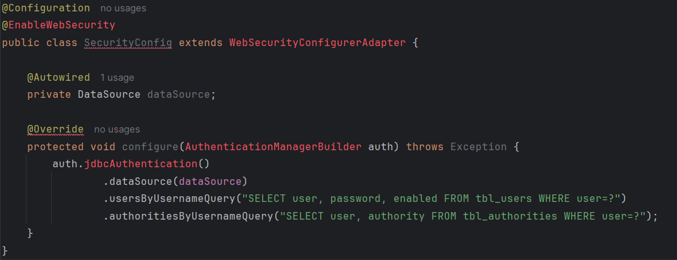
Authentication Providers - JDBC
.dataSource(dataSource): Configures the DataSource to connect to the database.
Ensure your application.properties includes the JDBC connection details
.authoritiesByUsernameQuery(): fetch user authorities (roles).
.usersByUsernameQuery():Defines the query to fetch user details (user, password, enabled).

Slide 36
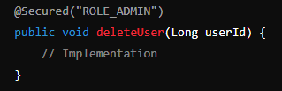
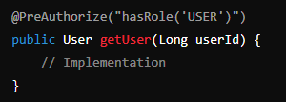
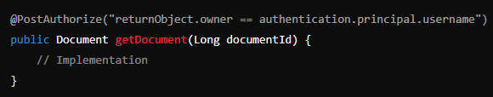
Basic Configuration Authorization: Annotations Approach
Annotate methods with
@Secured,
@PreAuthorize,
@PostAuthorize for method-level security

Slide 37
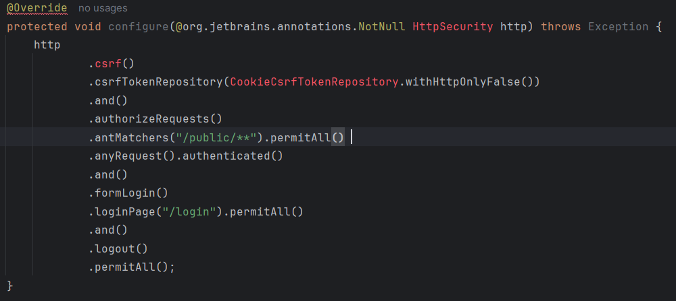
Common Security Filters
CsrfFilter: Prevents Cross-Site Request Forgery (CSRF) attacks.
Customizing CSRF Token Storage: CookieCsrfTokenRepository ensures the CSRF token is available in a cookie and can be accessed via JavaScript if withHttpOnlyFalse is set.
Form Login and Logout: Configuration for login and logout, allowing these endpoints to be accessible without authentication.

Slide 38
Common Security Filters
BasicAuthenticationFilter: Implements Basic Authentication
It locates the Basic Authentication header and authenticate the user by invoking the authentication manager.

Slide 39
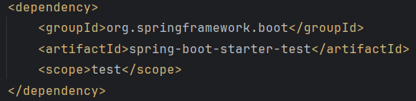
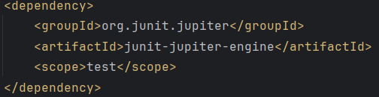
Introduction to Testing in Spring Boot
Purpose: Ensures application functions correctly and meets requirements.
Types of Test: JUnit
Ensure proper dependency is added to pom.xml file

Slide 40
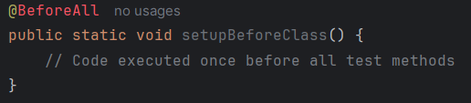
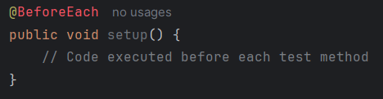
Structure of a JUnit Test Method
Annotations: @Test, @Before, @After, @BeforeClass, @AfterClass
@BeforeAll
Executed once before all test methods in the class.
Method must be static.
@BeforeEach
Executed before each test method.

Slide 41
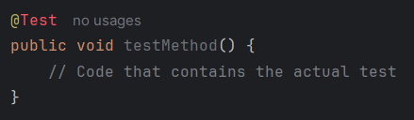
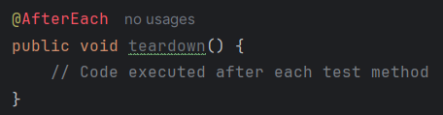
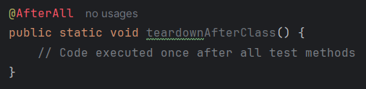
Structure of a JUnit Test Method
@AfterEach
Executed after each test method.
@Test
Marks a method as a test method.
@AfterAll
Executed once after all test methods in the class.
Method must be static.

Slide 42
Given-When-Then Pattern
Explanation of the pattern in software testing.
Advantages of using Given-When-Then for test readability and structure.
Given-When-Then Pattern Overview
Given: Set up the initial context or preconditions.
When: Execute the action or behavior to test.
Then: Verify the expected outcomes.

Slide 43
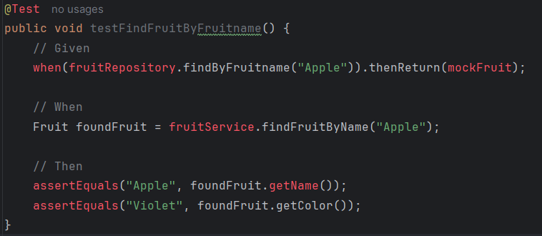
Given-When-Then Pattern Example
Given: Mock the behavior of fruitRepository.findByFruitname(“Apple") to return mockFruit.
When: Call fruitService.findFruitByFruitname(“Apple").
Then: Use assertEquals to verify the fruit name and color name of the found fruit.

Slide 44
Introduction to Monitoring
Importance of monitoring in application development.
Goals: Ensuring performance, availability, and reliability

Slide 45
Key Metrics to Monitor
Basic Metrics: CPU usage, memory usage, disk space.
Application-Specific Metrics: HTTP requests, database queries, cache hits/misses.
Health Checks: Application health indicators (/actuator/health).

Slide 46
Using Actuator for Monitoring
Spring Boot Actuator
Overview: Built-in support for monitoring and managing Spring Boot applications.
Endpoints: /actuator endpoints for metrics, health checks, info, etc.
1. Health Monitoring:
Use the /actuator/health endpoint to check the health status.
2. Metrics Monitoring:
Access /actuator/metrics for app metrics like memory usage, CPU usage, etc.
3. Application Info:
Provide application-specific information using /actuator/info.
4. HTTP Tracing:
Monitor HTTP request and response traces with /actuator/httptrace.

Slide 47
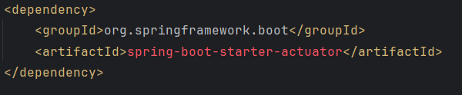

Enabling Actuator in Spring Boot
Add dependency to pom.xml file
Configure Actuator in application.properties:

Slide 48
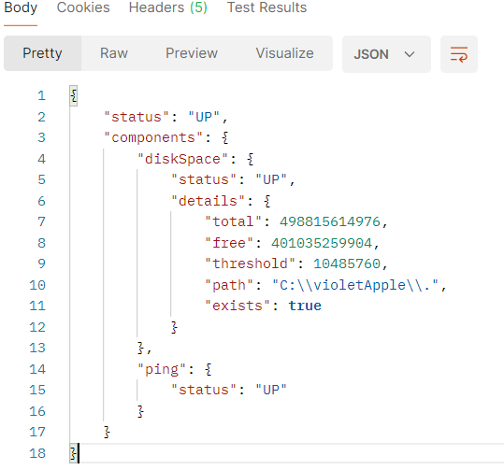
Exposing Actuator Endpoints O/P
Shows overall status of your application
Check Health:
Navigate to http://localhost:8080/actuator/health
diskSpace: Information about disk space availability.
ping: Basic connectivity check

Slide 49
Unit Testing

Slide 50
Spring Dependency Injection: E-Commerce Service

Slide 51
Spring Inversion of Control(IOC): Arcade Game Manager

Slide 52
Spring City Zoo

Slide 53
Programmer to API Developer Sandbox

